Slide 1
ANN and Hysteresis Based Controllers for Improved Performance of BLDC Motor Drives
ATHULITHA YASHASWINI-12040610
LAHARI SREEJA-12041570
PRODDUTOORI VAMSHIKA-12041150
MADDELA SUPRIYA-12040810

Slide 2
INTRODUCTION
Artificial Neural Network (ANN) is the simple network which has input, output, and hidden layers with a set of nodes. Implementation of ANN algorithms in electrical, and electronics engineering always satisfies with the expected results as ANN handles binary data more accurately. Brushless Direct Current motor (BLDC motor) uses electronic closed-loop controllers to the switch DC current to the motor windings and produces the magnetic fields.The usage of BLDCM enhances various performance factors ranging from higher efficiency, higher torque in low-speed range, high power density ,low maintenance and less noise than other motors and it is very easy to control its speed by Power Converters.The BLDCM can act as an alternative for traditional motors like induction and switched reluctance motors. The control is done by using a hysteresis current controller. The motor is modeled in the MATLAB/Simulink .Hysteresis control, EMF signals, rotor speed, electromagnetic torque, Hall Effect signals, PWM and EMF signals simulations are obtained. The obtained data is fed into binary artificial neural networks and as a result, the ANN model predicts the corresponding parameters close to the simulation results. Both the mathematical based simulation and data based prediction gives satisfactory results.

Slide 3
BLDC MOTORS
The BLDC motor has windings on its stator and permanent magnets on its rotor. The role of permanent magnets is to produce the rotor flux. The stator windings generate electromagnetic poles that attract the rotor and makes the rotor to rotate. The permanent magnets in BLDC motor rotate around an immobile armature, eradicating the challenges with linking current to the movable armature. The electronic controller in the BLDC motors, constantly switches the winding phases. Similar timed power distribution is produced by the controller when a solid-state circuit is used instead of a brush or commentator combination. The BLDC motor works in several phases, wherein the 3 phase motor is highly preferred and a popular system due to its very high efficiency it produces low torque and also accurate control.Brushless DC motors (BLDC) use for a wide variety of application requirements such as varying loads, constant loads and positioning applications in the fields of industrial control, automotive, aviation, automation systems, health care equipments etc.

Slide 4
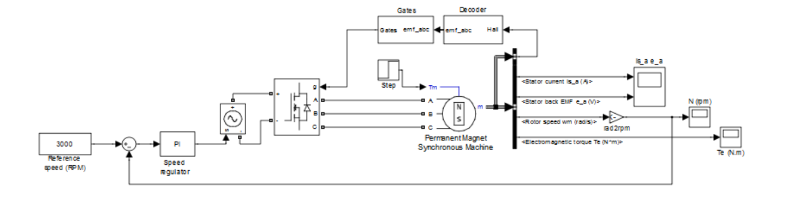
Without Hysteresis current control loop
The above figure shows the block diagram of the closed loop operation of BLDC motor drive without hysteresis control.

Slide 5
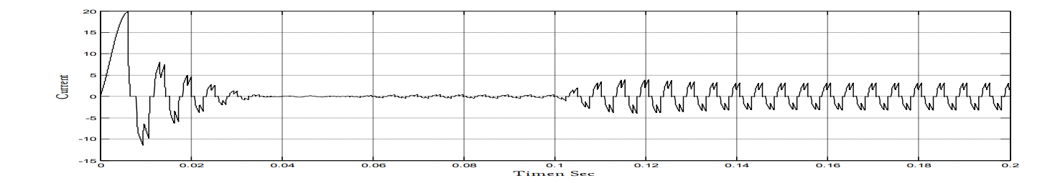
Without Hysteresis current control loop example
The above figure shows the dynamic behavior of the motor when speed reference is set at 3000 rpm.A current of 20 amps is observed at the time of starting, at t= 0.04 motor taking a current of 0.1 amps at no load. At t=0.1 second motor is developing a torque of 3Nm and having a steady state stators current of 4.5 amps. Motor speed reached to set value of speed with a very small dip.

Slide 6
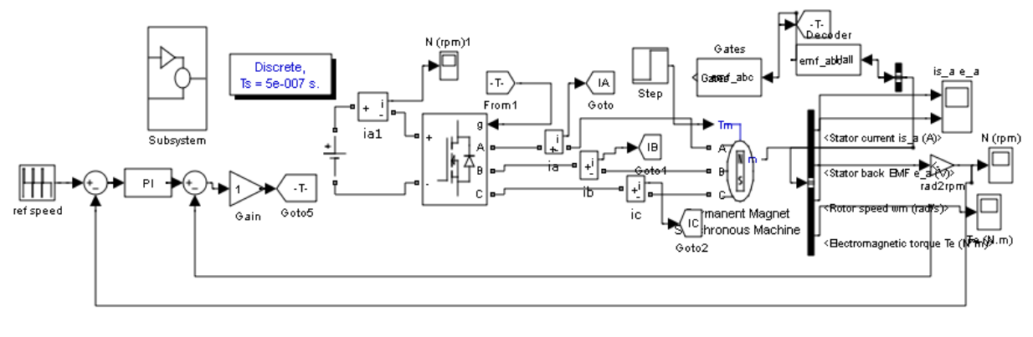
With Hysteresis control
The above figure shows the simulink block diagram of the closed loop operation of BLDC motor drive with hysteresis control.

Slide 7
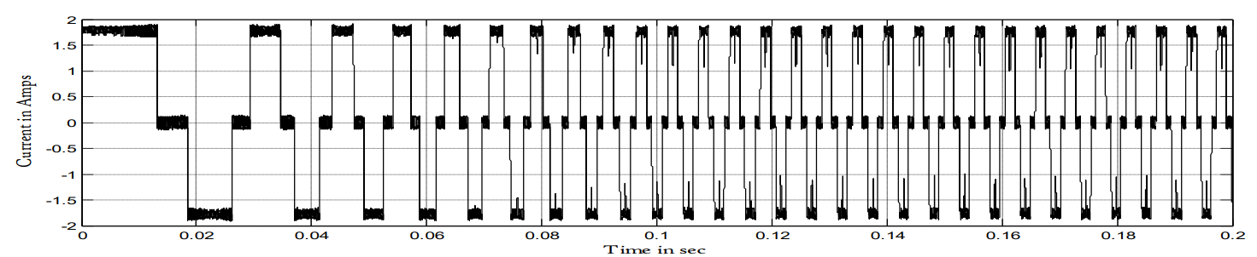
With Hysteresis control example
The above figure shows the Dynamics of the motor with hysteresis current controller. It is observing that magnitude of starting currents are very less compared with without hysteresis current controller, here the magnitude of starting current is 1.75amps at the time of starting.

Slide 8
ARTIFICIAL NEURAL NETWORKS
The Artificial Neural Network is a biologically inspired neural network that comes under the hood of Deep learning.The data processing and transformation are very similar to that of the data transfer and processing in the human brain ANN structure mainly consists of an input layer, an output layer and more importantly a set of hidden layers. The input neuron receives input (data) and assigns weights to it and multiply them. Then they are added and passed on to the next neuron by applying some activation function.The main ability of the neural network to perform a task depends on the accurate adjustment of the weights. The weights are adjusted by the process of training the neural network with the training data. With the training, the trained neural network can predict new data fed into it.The propagation of the neural network is based on two principles i.e., Forward propagation and Backward propagation.

Slide 9
PROPOSED SYSTEM
The system proposed is the effective method of control of the Brushless Direct Current Motor (BLDC). The proposed method is based on the controlling of input DC Voltage of the bridge converter. The input DC voltage of the bridge converter is controlled as it feeds the motor windings which creates a magnetic field and in turn rotates the motor.Hysteresis current controller is implemented with speed feedback loop and it is observe that torque ripples are minimized.Simulation is carried out using MATLAB / SIMULINK.Hysteresis controller is simple to implement and produces a very good quality of waveform.The drawback of this method is that the switching frequency does not remain constant but varies along different portions of the desired current. So we want to implement ANN to improve its performance even further.

Slide 10
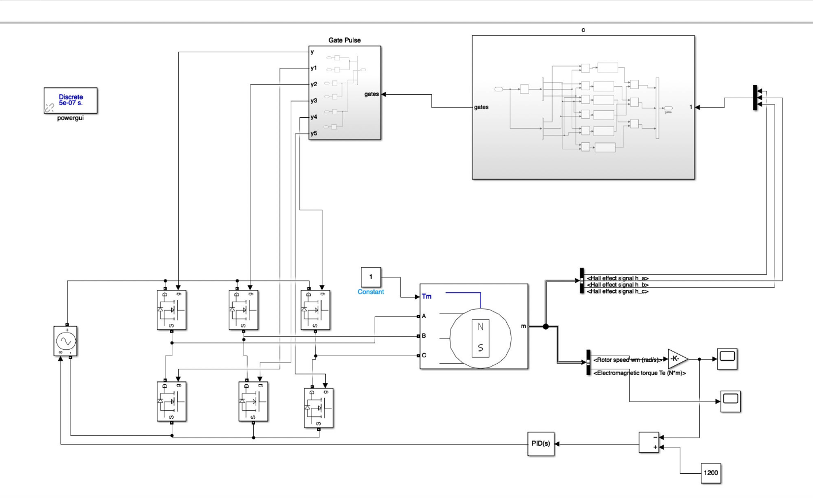
SIMULATION
The system is simulated using MATLAB/Simulink. The circuit includes bridge converter, BLDC motor, PI controller ,Hysteresis current controller and other necessary electrical components necessary to simulate the system.

Slide 11
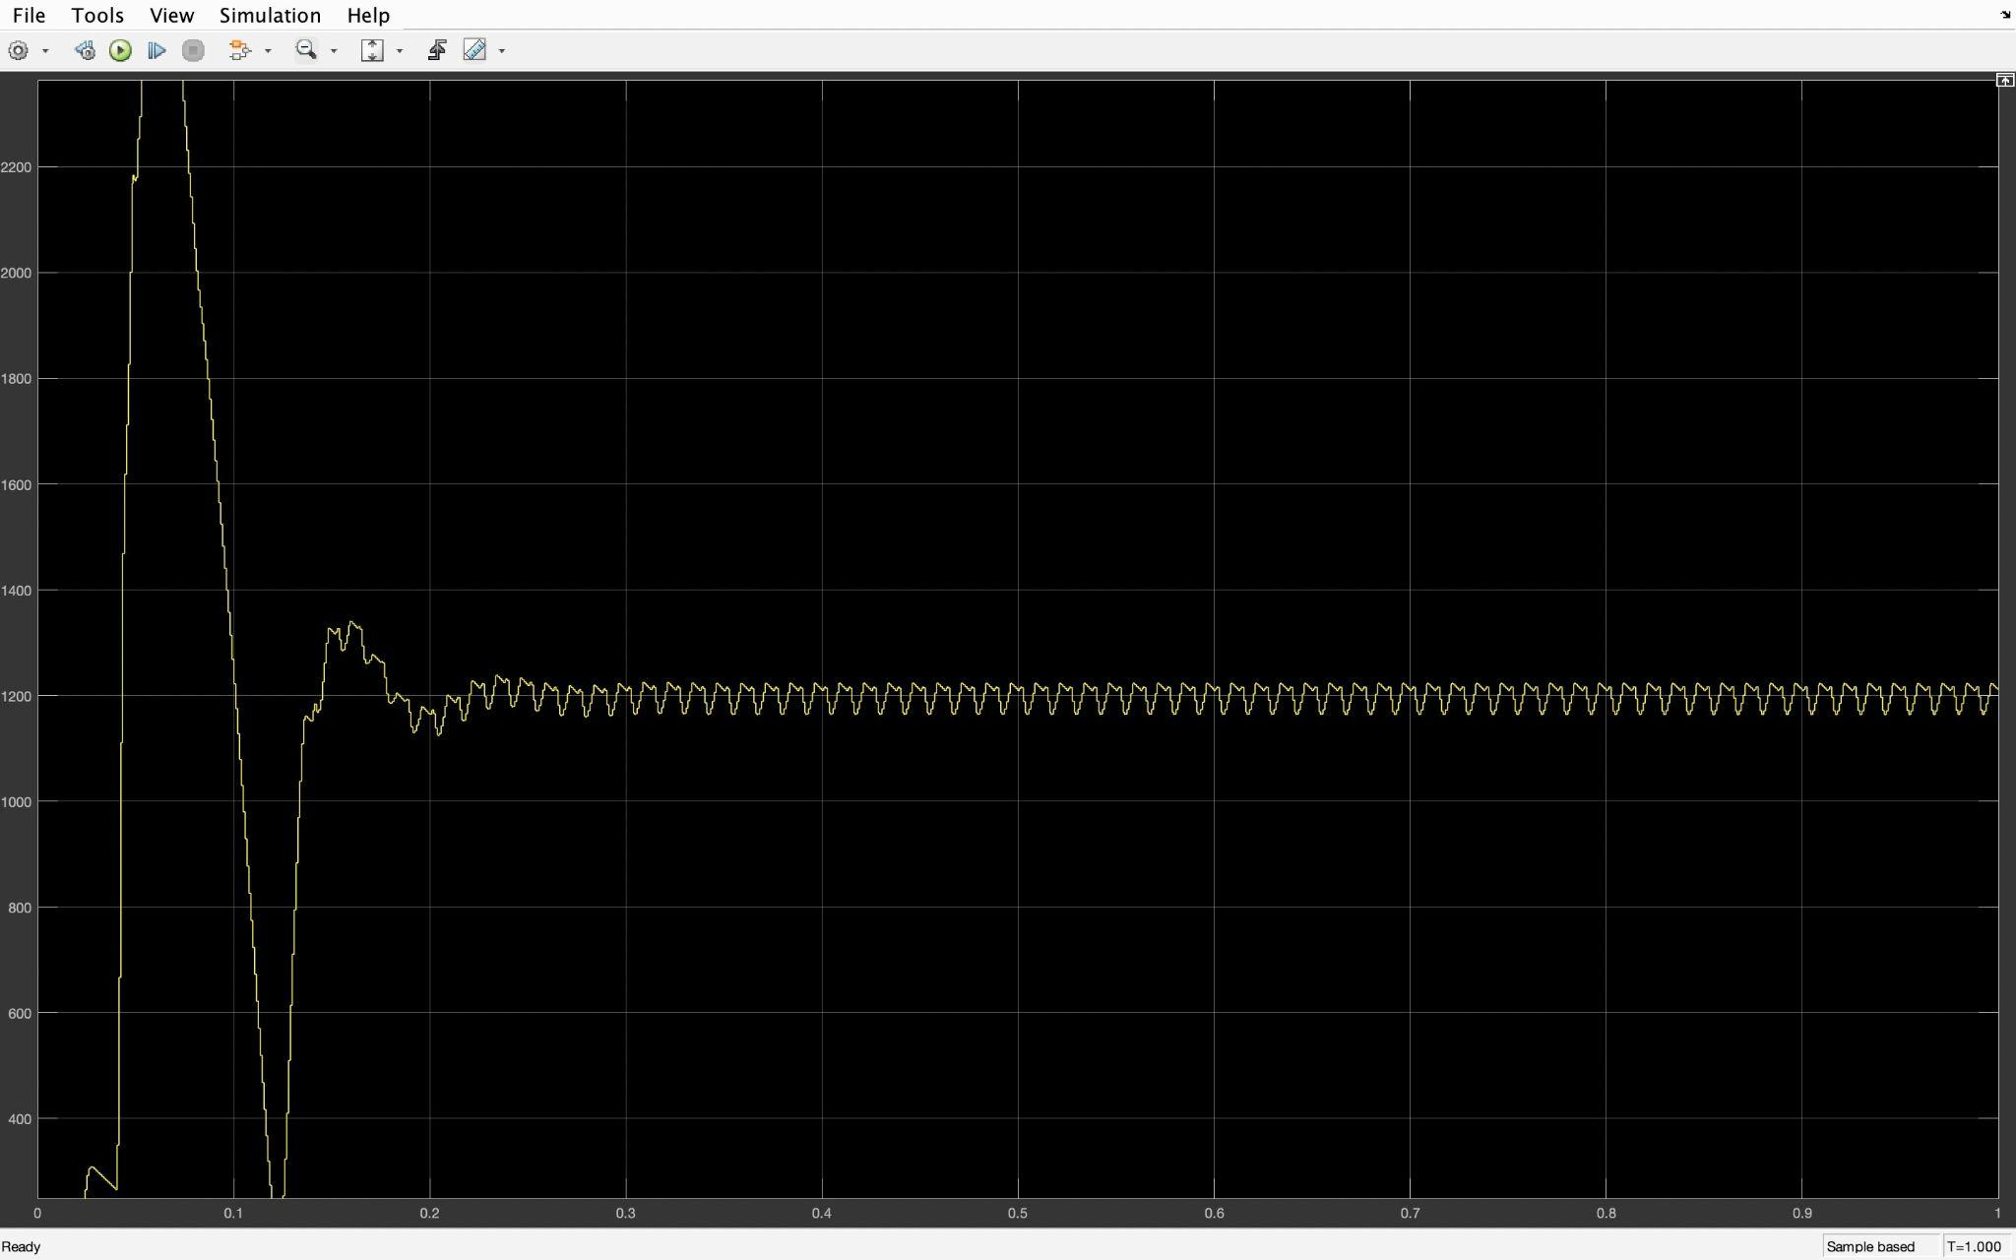
BLDC motor with hysteresis controller
Rotor speed (rpm) versus time (sec)

Slide 12
ANN IMPLEMENTATION
The data generated from the simulation of Brushless Direct Current motor with Hysteresis controller simulation are collected in matlab from pi controller. The multiple parameters obtained from the simulation results are compared with each other and fed into an Artificial Neural Network (ANN). The experiment is proceeded by first selecting parameters to compare and then fed them into an ANN built for it and observing the training data.The ANN is consisting of layers and nodes in each layer except in the input and the output layer.The training and test set is split in the ratio of 80:20 and iterations run to get the specified output.
The system is now complete and it can be used in SIMULINK to improve the performance of the bldc motor.

Slide 13
CONCLUSION
In this project, an effective method for speed control of BLDC motor is proposed. The proposed method is based on controlling the input of DC voltage of bridge converter which feeds the motor windings. The input is controlled using Hysteresis controller. For the proposed system the data is fed into to a binary Artificial Neural Network for various parameters obtained from the simulation. The simulation results and prediction result so obtained are synonymous. The activation function and neuron for each layer is altered and studied with respect to the input data. This improves the overall performance of BLDC motor.

Slide 14
THANK YOU

